Slide 1
Welcome to the Qualtrics Workshop!
Please go to illinois.qualtrics.com and sign in with your Illinois netID and password
Be ready with questions or issues you may have with your own surveys or projects – we will have time to discuss them
Center for Innovation in Teaching & Learning (CITL)

Slide 2
Introduction to Qualtrics
Instructor: Nathan Jeffery
Center for Innovation in Teaching & Learning (CITL)
Last updated: 2026-02-18

Slide 3
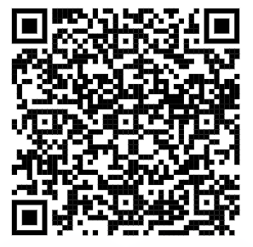
Request a consultation
Scan the QR code to submit a request or follow the link below.
Consulting is open to all University of Illinois students, faculty, and staff during the Fall, Spring and Summer 2 semesters.
People are encouraged to contact us for appointments by submitting a request. Drop-in questions during consulting hours are welcome either through Zoom during our virtual drop-in hours or in person at Scholarly Commons 220 Main library.
go.illinois.edu/requestconsult
Center for Innovation in Teaching & Learning (CITL)

Slide 4
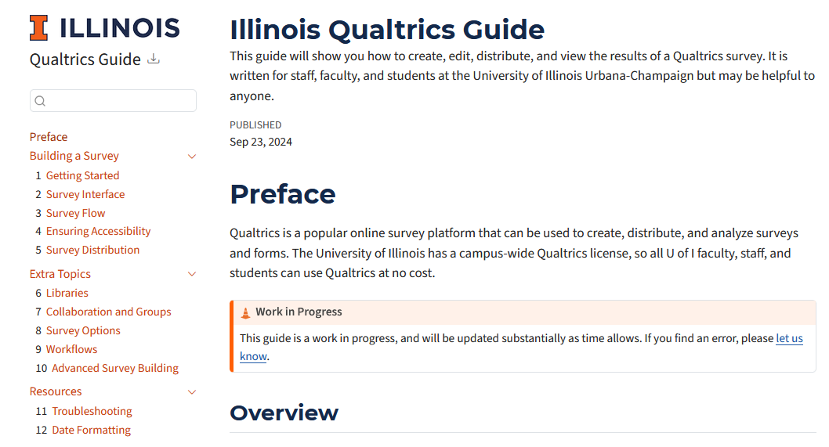
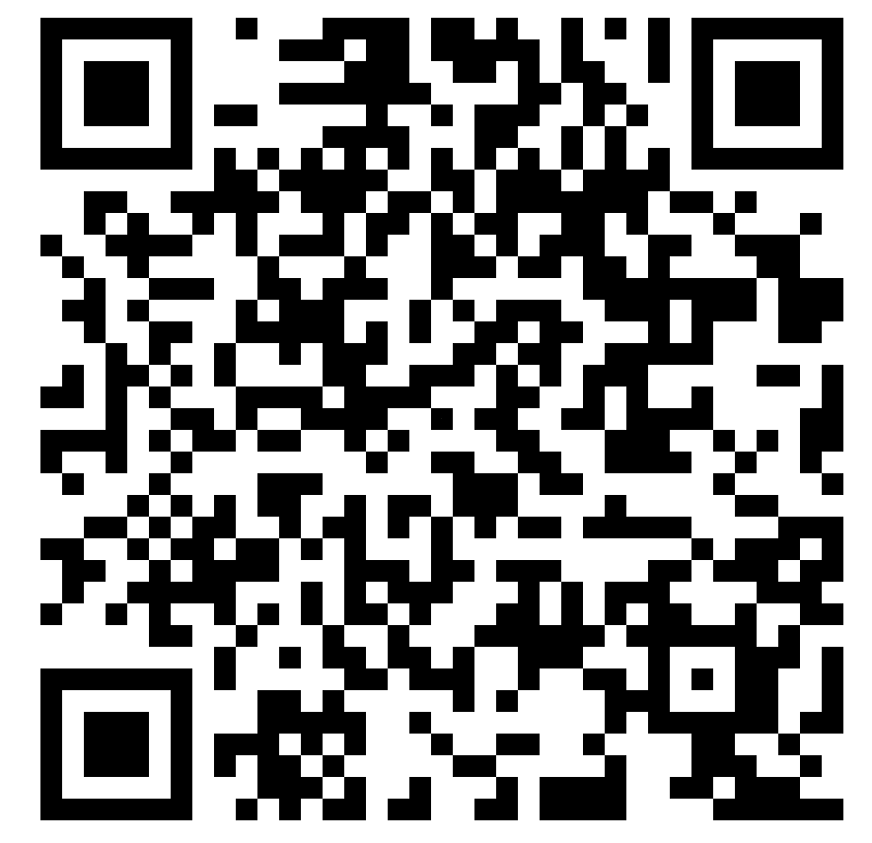
Campus Qualtrics Guide (work in progress)
Scan the QR code to access the guide or follow the link below.
go.illinois.edu/qualtricsguide
Center for Innovation in Teaching & Learning (CITL)

Slide 5
Agenda
How to navigate in Qualtrics
How to design a survey
  Types of questions
  Survey flow
  Survey logic
  Getting informed consent and preventing spam
  Make your survey accessible
  Personalize your survey
How to distribute a survey
How to view/export your survey responses
Center for Innovation in Teaching & Learning (CITL)

Slide 6
What is your goal for today’s workshop?
Center for Innovation in Teaching & Learning (CITL)
6

Slide 7
Navigating Qualtrics
Center for Innovation in Teaching & Learning (CITL)

Slide 8
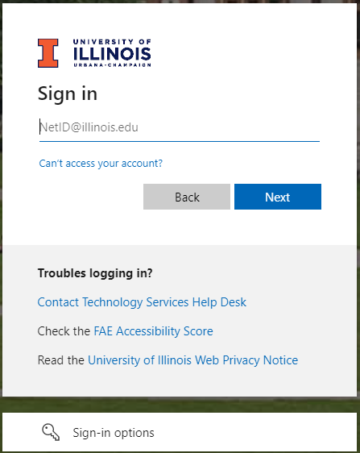
Log into your Qualtrics Account
Go to illinois.qualtrics.com
(NOT www.qualtrics.com)
Login with your NetID and Password
Center for Innovation in Teaching & Learning (CITL)

Slide 9
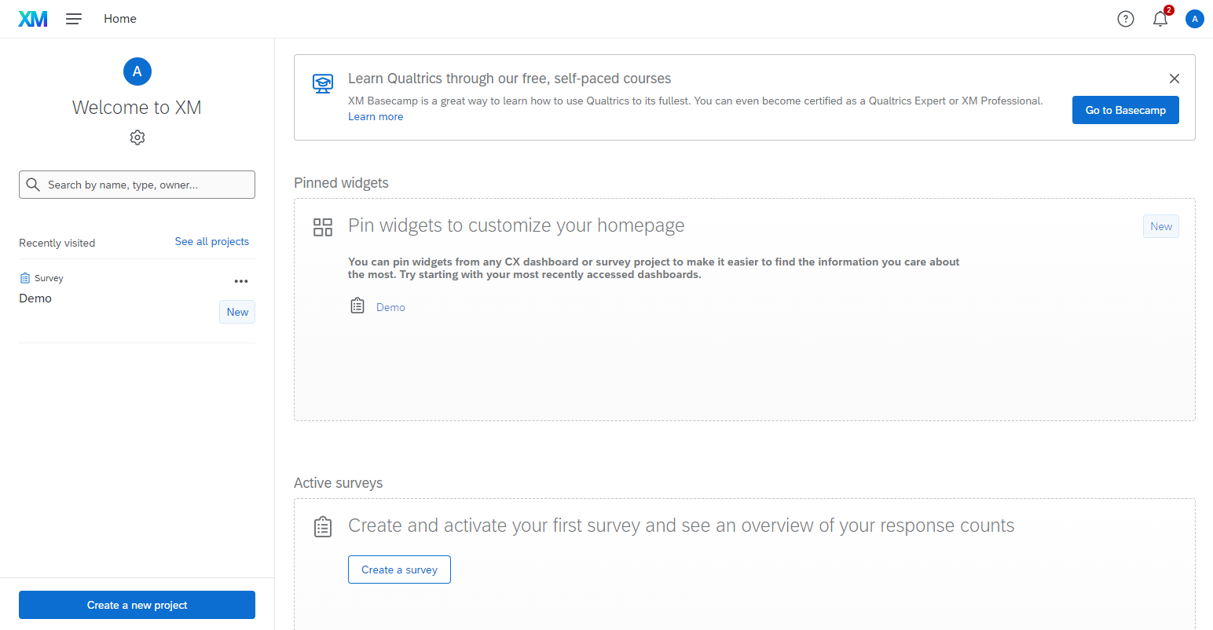
Create a New Project (1)
Center for Innovation in Teaching & Learning (CITL)

Slide 10
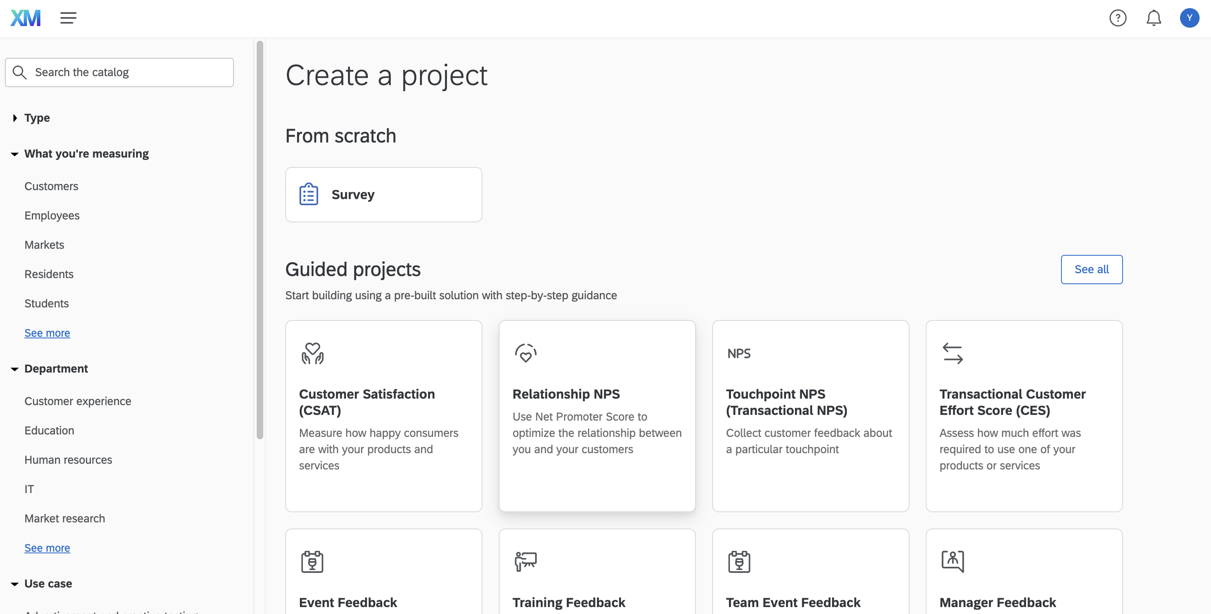
Create a New Project (2)
Center for Innovation in Teaching & Learning (CITL)

Slide 11
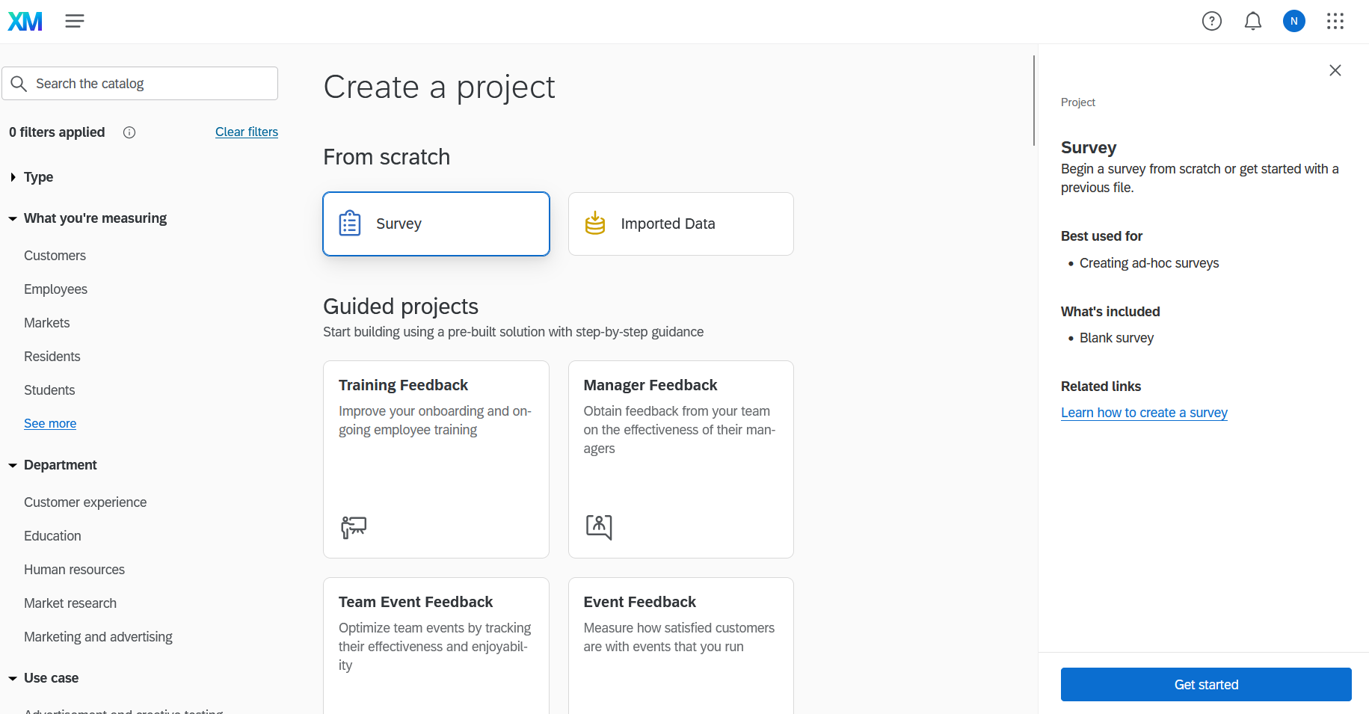
Create a New Project (3)
Center for Innovation in Teaching & Learning (CITL)

Slide 12
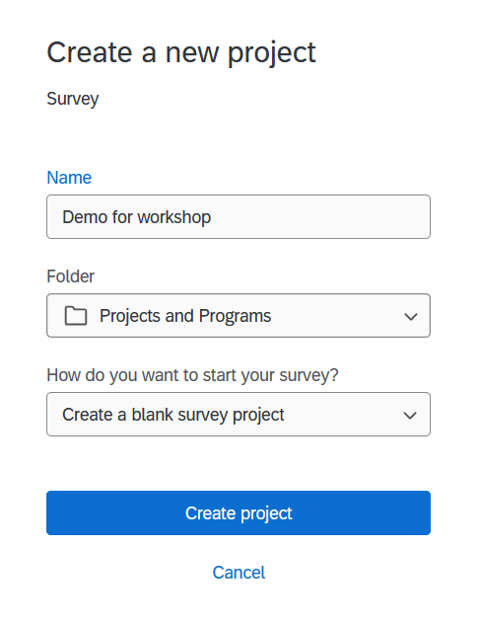
Create a New Project (4)
Center for Innovation in Teaching & Learning (CITL)

Slide 13
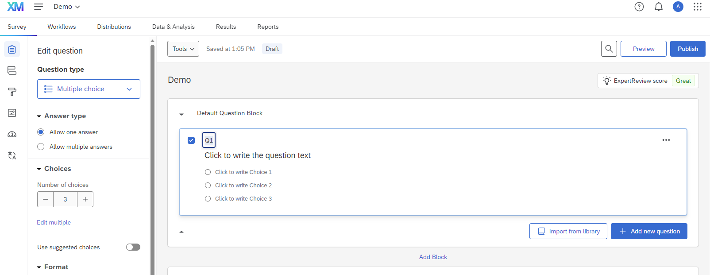
Survey builder layout
Question editing pane
Question block
Survey toolbar
Question editing area
Center for Innovation in Teaching & Learning (CITL)

Slide 14
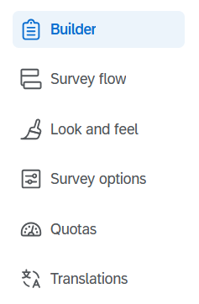

Survey Toolbar
The button in the bottom-left corner shows the toolbar labels
Center for Innovation in Teaching & Learning (CITL)

Slide 15
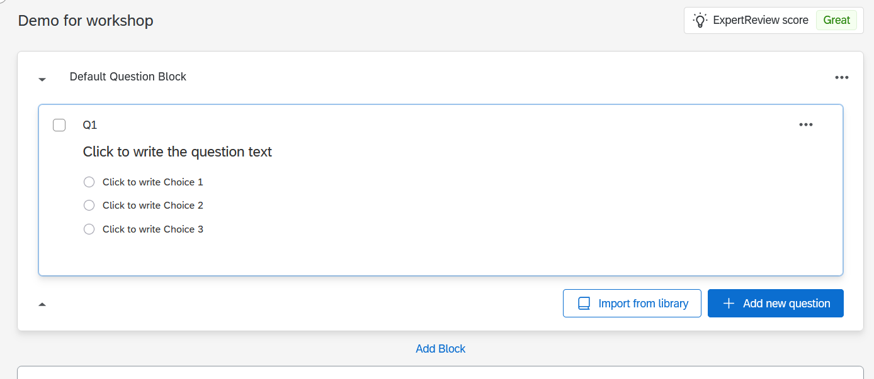
Blocks (1)
Center for Innovation in Teaching & Learning (CITL)

Slide 16
Blocks (2)
What are blocks?
  A way to group survey questions
When use blocks?
  Simple survey? Maybe one block is enough
  Complex survey? Break into blocks!
Benefits of blocks?
  Survey logic
  Organization
Center for Innovation in Teaching & Learning (CITL)

Slide 17
Blocks in a research study (1)
Introduction
Demographics
A few independent variable (IV) blocks
A few dependent variable (DV) blocks
Optional: manipulation check
Debriefing
Center for Innovation in Teaching & Learning (CITL)

Slide 18
Blocks in a research study (2)
Introduction block
  Example: “This study is about Halloween candy preferences.
  Please read the questions carefully and thoroughly and answer them honestly.
  This survey takes approximately 5 minutes.”
Demographic block
A few independent variable (IV) blocks
  A block for the experimental condition
  A block for the control condition
A few dependent variable (DV) blocks
Optional: A manipulation check block (if you have an experimental design)
One debriefing block
  Example: “This is the end of this survey. Thank you for participating in this study.
  To receive credit for this survey in Mturk, use the following code: 321868.”
Center for Innovation in Teaching & Learning (CITL)

Slide 19
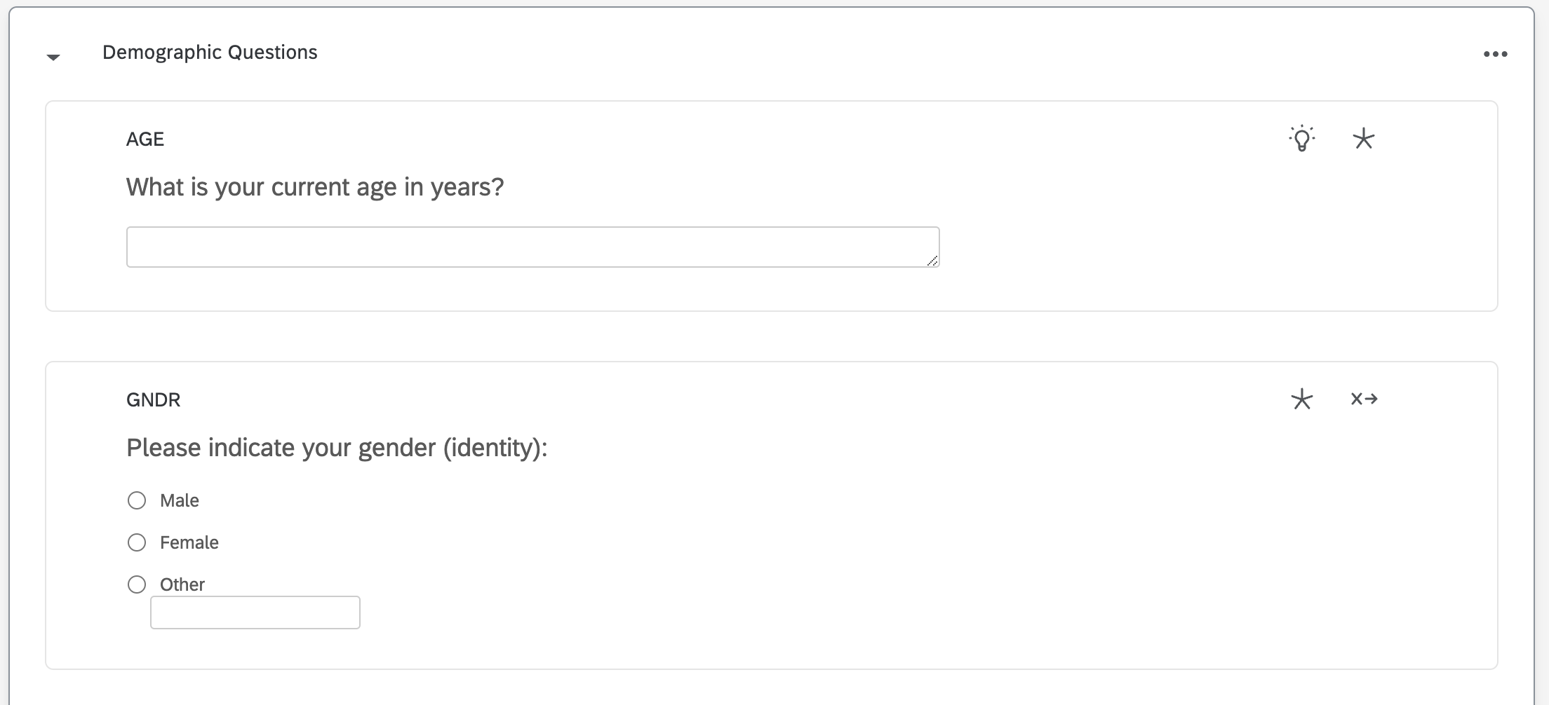
Name your blocks
Block names appear in the Survey Flow
Center for Innovation in Teaching & Learning (CITL)

Slide 20
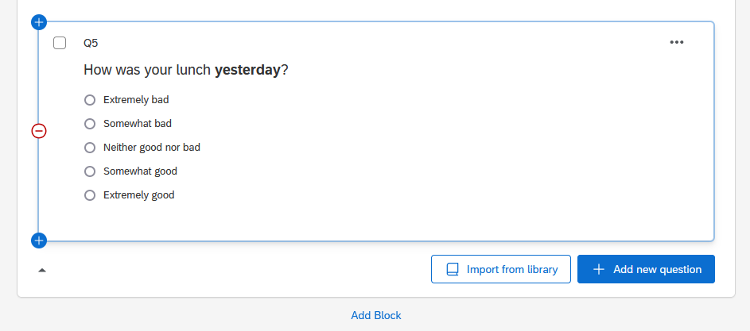
Add and delete questions
Center for Innovation in Teaching & Learning (CITL)

Slide 21
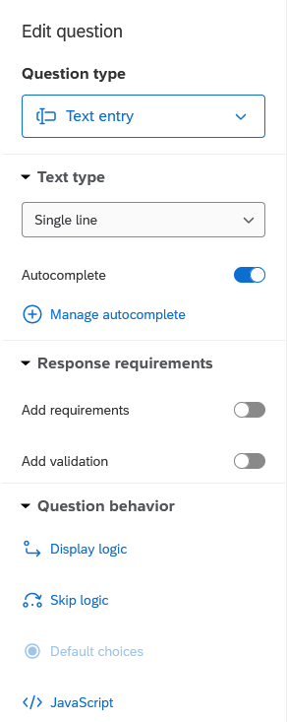
Question editing pane
Changes depending on the type of question you’re editing
Lets you edit:
  The type of question
  The answer choices
  Whether the question is required
  Display and skip logic
Center for Innovation in Teaching & Learning (CITL)

Slide 22
Name your questions
Question names appear in your survey responses
Examples:
Age
Gender
For research studies:
  DV: (name of your DV)
  Manipulation check (MC)
Center for Innovation in Teaching & Learning (CITL)

Slide 23
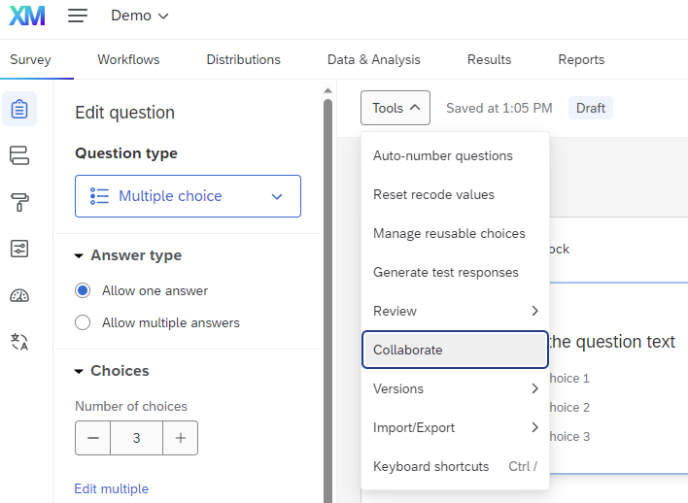
Collaboration (1)
Center for Innovation in Teaching & Learning (CITL)

Slide 24
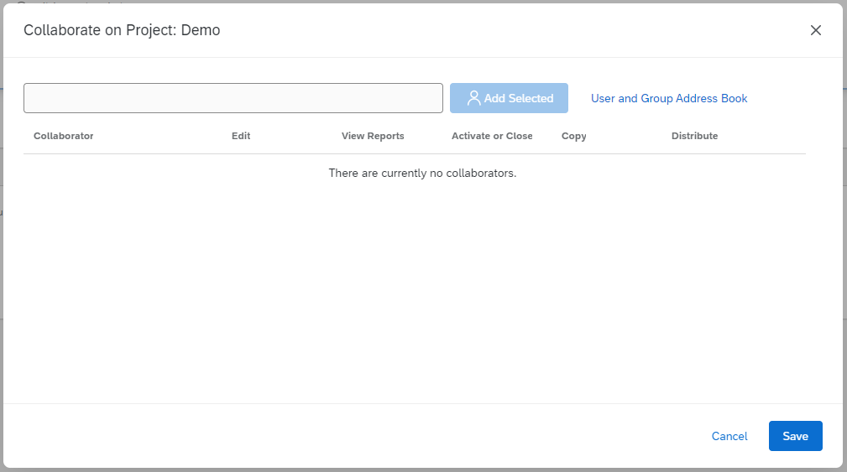
Collaboration (2)
Start typing their name / email
Internal: should autofill
  If it doesn’t autofill, tell them to log in to Qualtrics
External: sends them an email
Center for Innovation in Teaching & Learning (CITL)

Slide 25
Designing your Survey
Center for Innovation in Teaching & Learning (CITL)

Slide 26
Designing your Survey:
Types of Questions
Center for Innovation in Teaching & Learning (CITL)

Slide 27
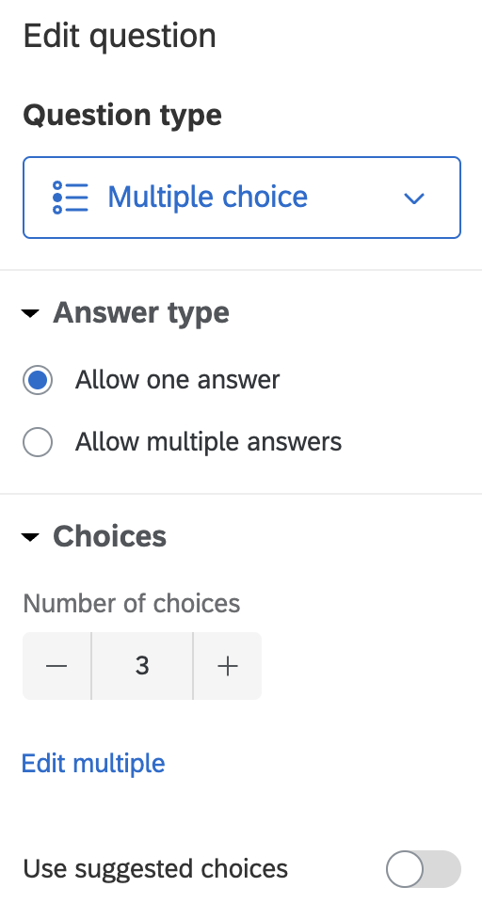
Types of Questions
Multiple choice
Matrix table
Text entry
Text / Graphic
Many other types exist
Center for Innovation in Teaching & Learning (CITL)

Slide 28
Types of Questions: Multiple choice (1)
Center for Innovation in Teaching & Learning (CITL)

Slide 29
Types of Questions: Multiple choice (2)
Center for Innovation in Teaching & Learning (CITL)

Slide 30
Types of Questions: Multiple choice (3)
Center for Innovation in Teaching & Learning (CITL)

Slide 31
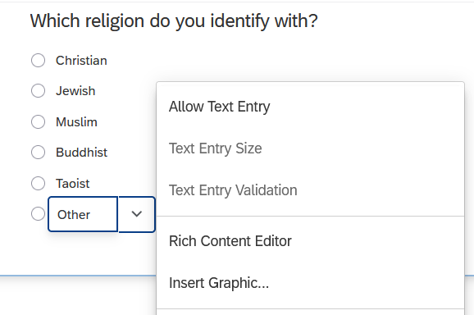
Types of Questions: Multiple choice (4)
What if you want to allow text entry in a multiple-choice question?
Note: In general, avoid text entry for “why” questions
Center for Innovation in Teaching & Learning (CITL)

Slide 32
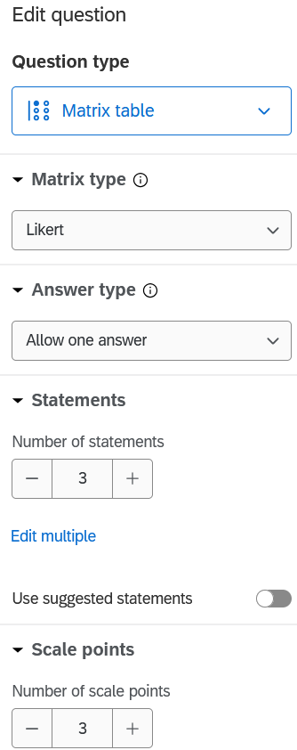
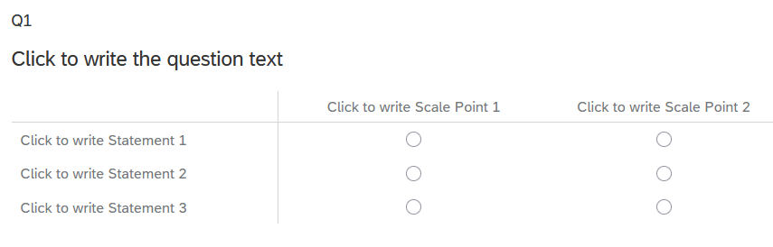
Types of Questions: Matrix table (1)
Center for Innovation in Teaching & Learning (CITL)

Slide 33
Types of Questions: Matrix table (2)
Question text:
  How often do you do each of the following activities?
Statements:
  (the activities)
Scale Points:
  Never, Rarely, Sometimes, Often, All the time
Center for Innovation in Teaching & Learning (CITL)

Slide 34
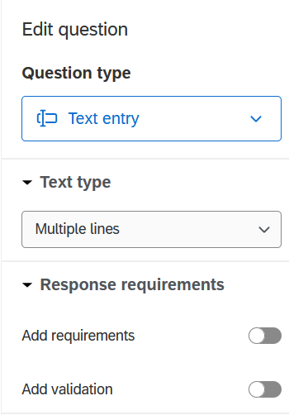
Types of Questions: Text entry (1)
Center for Innovation in Teaching & Learning (CITL)

Slide 35
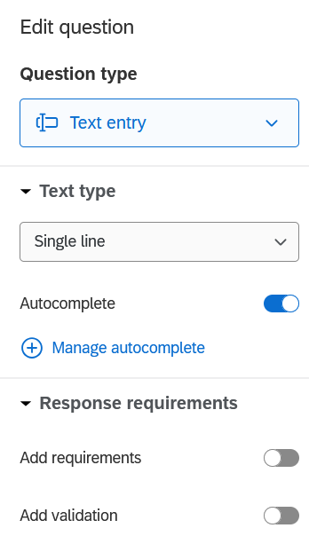
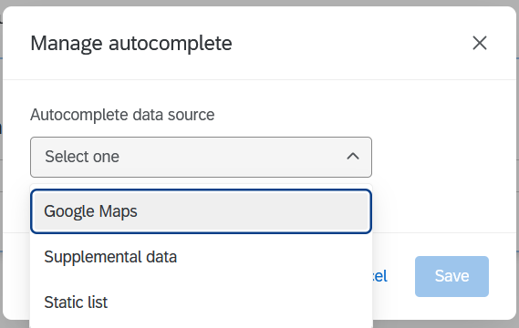
Types of Questions: Text entry (2)
Center for Innovation in Teaching & Learning (CITL)

Slide 36
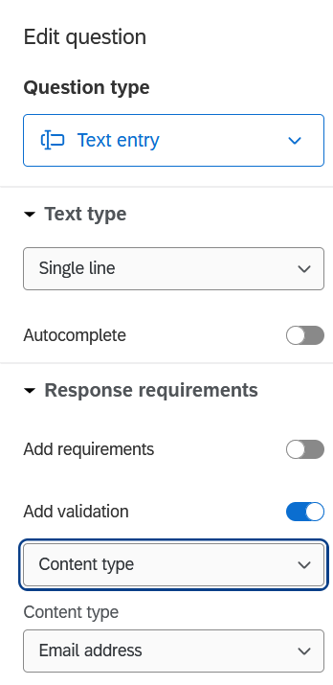
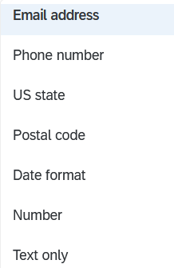
Types of Questions: Text entry (3)
Center for Innovation in Teaching & Learning (CITL)

Slide 37
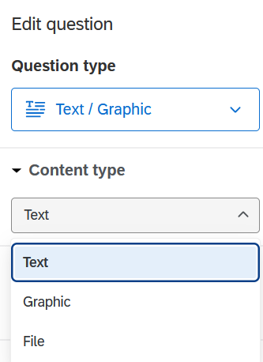
Types of Questions: Text / Graphic (1)
Graphic is not accessible
Instead, choose Text and use the Rich content editor
Center for Innovation in Teaching & Learning (CITL)

Slide 38
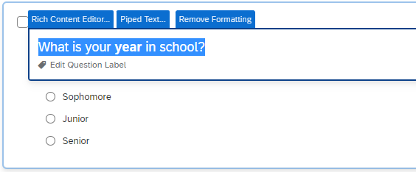
Rich Content Editor
Center for Innovation in Teaching & Learning (CITL)
Notes:
Try it:
Create a question and format it
Add an image to a question

Slide 39
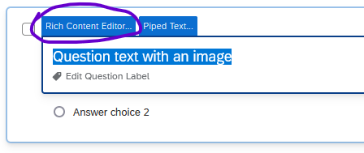
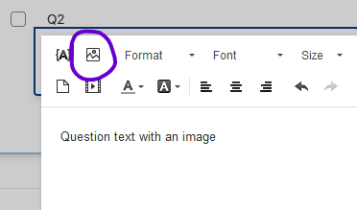
Rich Content Editor: Images (1)
To add an image, DON’T use “Add graphic.”
(It doesn’t accept alt text.)
Instead, add text
Then open the Rich Content Editor and click the image icon to add the image
See also: Qualtrics documentation on Image Properties
Center for Innovation in Teaching & Learning (CITL)
Notes:
Try it with the image you inserted

Slide 40
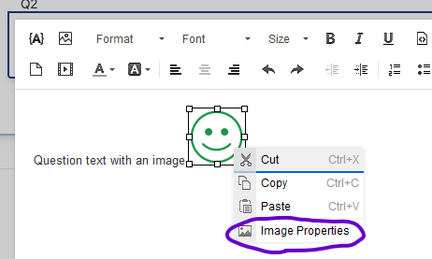
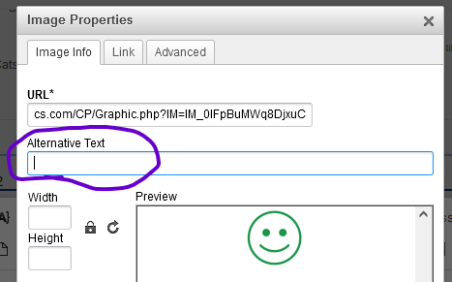
Rich Content Editor: Images (2)
When the image appears, right-click it and choose Image Properties
Add the alt text to the field and click OK
Center for Innovation in Teaching & Learning (CITL)

Slide 41
Designing your Survey:
Survey Flow
Center for Innovation in Teaching & Learning (CITL)

Slide 42
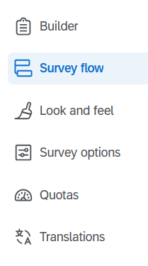
Survey Flow
Center for Innovation in Teaching & Learning (CITL)

Slide 43
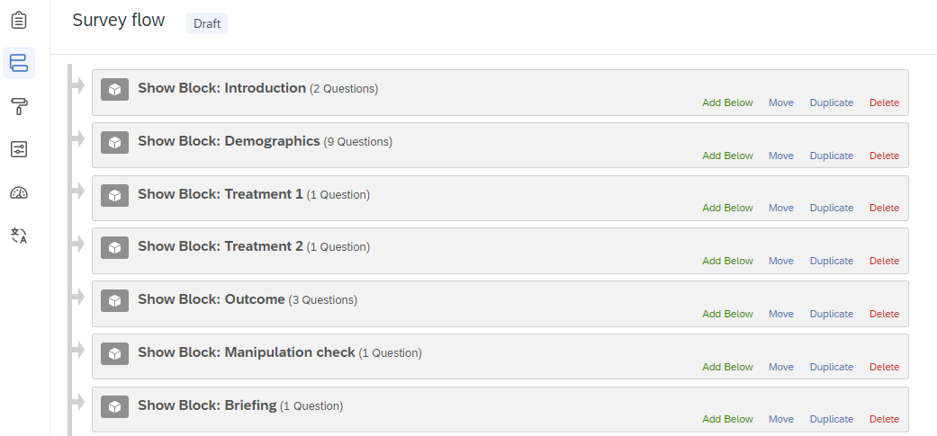
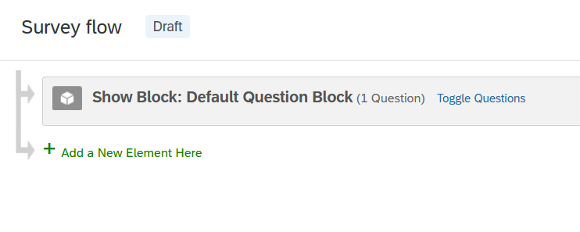
Survey Flow: Simple vs Complex
Center for Innovation in Teaching & Learning (CITL)

Slide 44
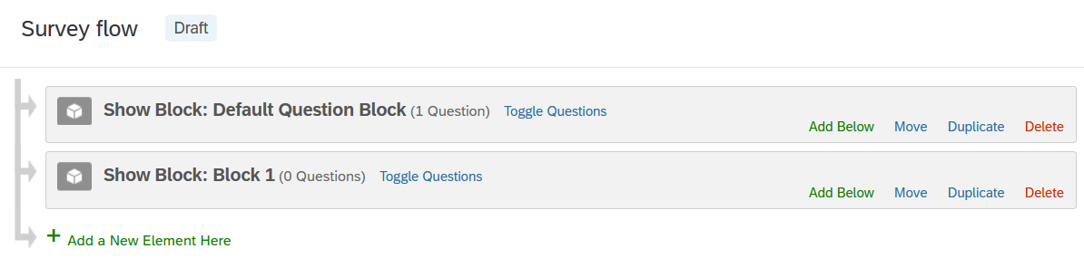
Adding to the Survey Flow (1)
Center for Innovation in Teaching & Learning (CITL)

Slide 45
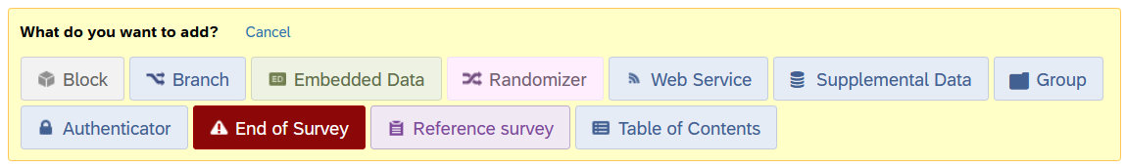
Adding to the Survey Flow (2)
Center for Innovation in Teaching & Learning (CITL)

Slide 46
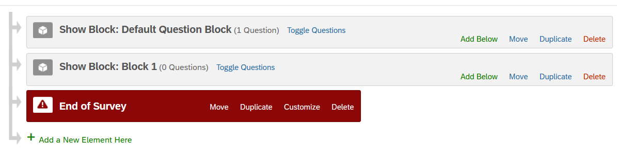
End of Survey (1)
Center for Innovation in Teaching & Learning (CITL)

Slide 47
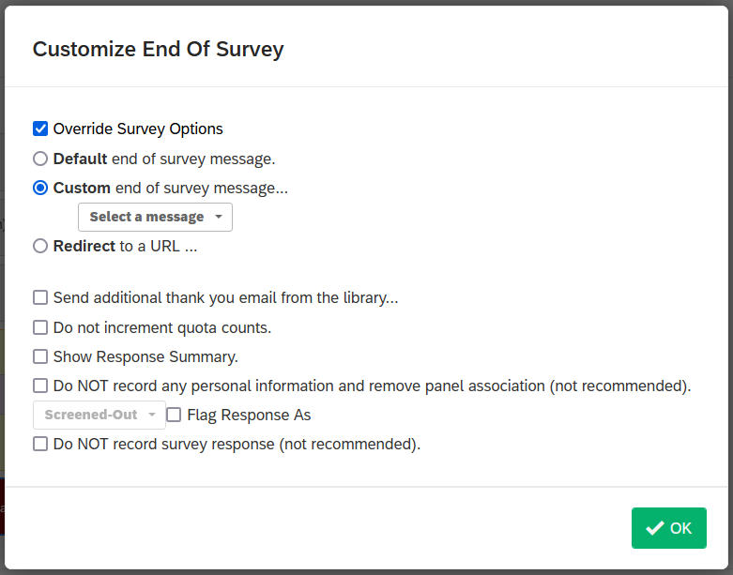
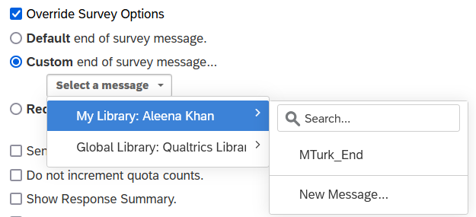
End of Survey (2)
Click Override Survey Options, then select Custom end of survey message
Center for Innovation in Teaching & Learning (CITL)

Slide 48
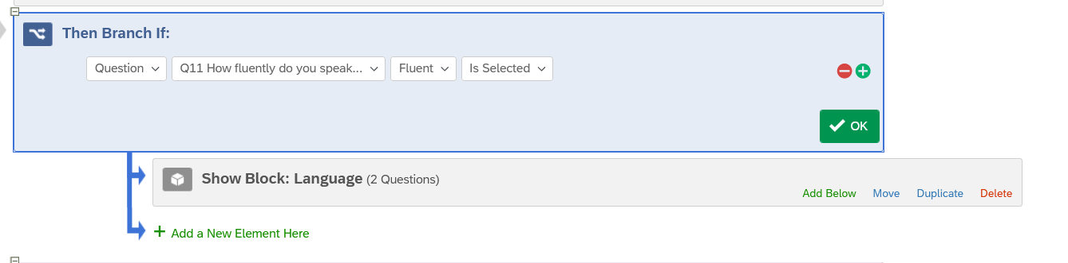
Branching
Select the criteria for branching
(Often a question or embedded data)
Select the condition that needs to be met
Move blocks or other elements under the branch logic by clicking and dragging the elements where they say “Move”
Center for Innovation in Teaching & Learning (CITL)

Slide 49
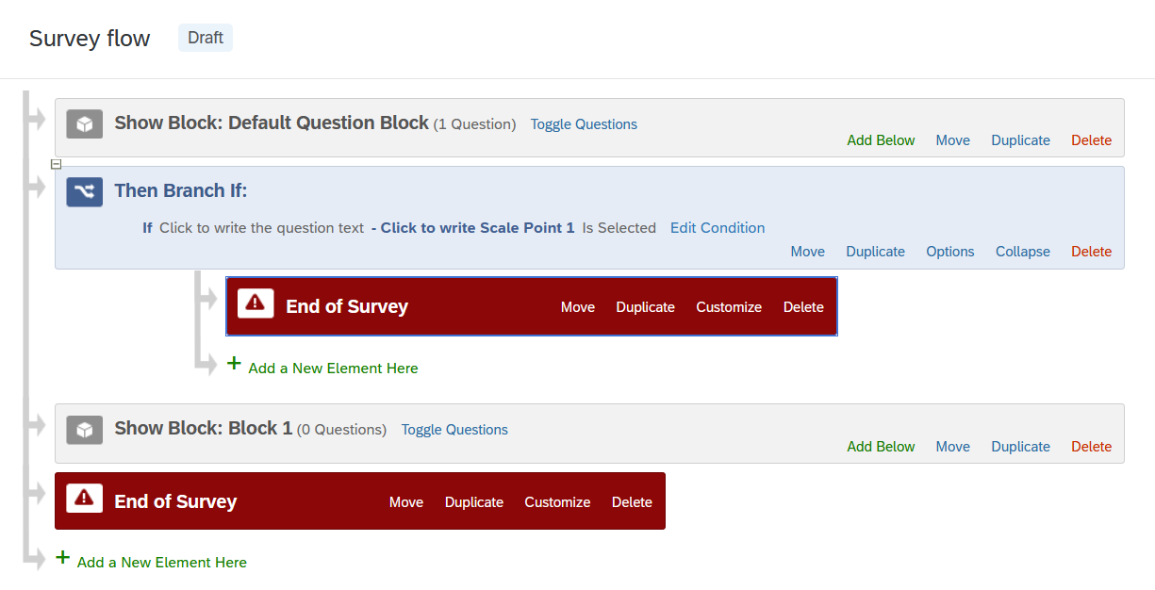
Survey Flow (example)
Center for Innovation in Teaching & Learning (CITL)

Slide 50
Designing your Survey:
Survey Logic
Center for Innovation in Teaching & Learning (CITL)

Slide 51
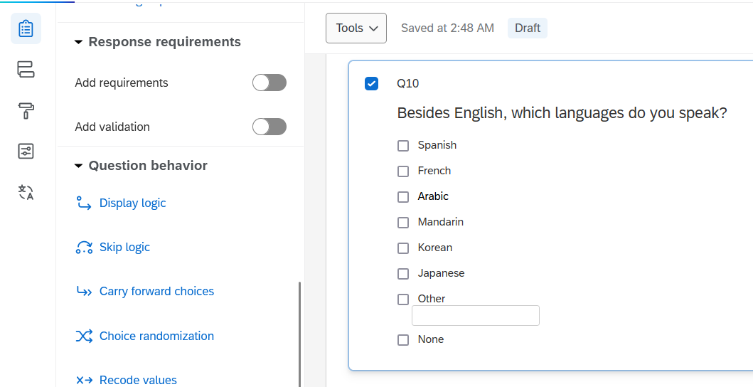
Skip Logic (1)
Center for Innovation in Teaching & Learning (CITL)

Slide 52
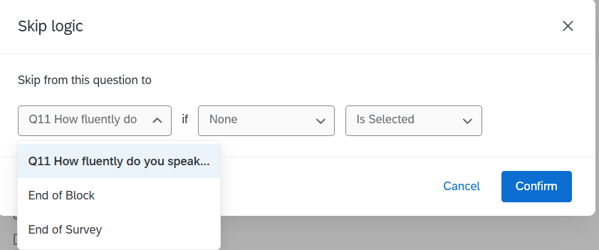
Skip Logic (2)
You can skip to:
a particular question
the end of the block
or the end of the survey
Center for Innovation in Teaching & Learning (CITL)

Slide 53
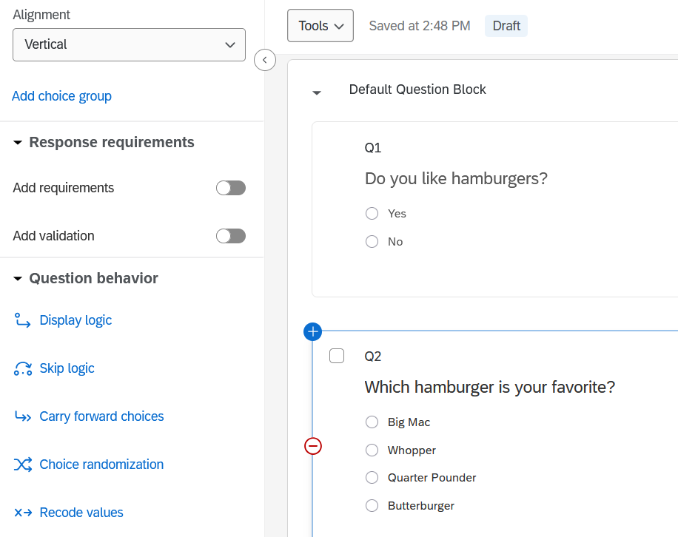
Display Logic (1)
Center for Innovation in Teaching & Learning (CITL)

Slide 54
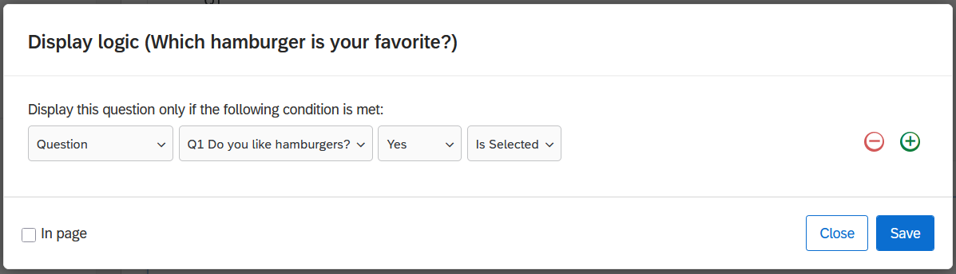
Display Logic (2)
Center for Innovation in Teaching & Learning (CITL)

Slide 55
Deleting Questions
When you delete a question, it moves to the Trash at the bottom of the page
  While it is in the trash, it will not appear in Qualtrics reports or data exports
From the trash, you can restore it or delete it forever
  If you delete it forever, any responses to it will be deleted as well
Center for Innovation in Teaching & Learning (CITL)

Slide 56
Informed consent and preventing spam
Center for Innovation in Teaching & Learning (CITL)
56

Slide 57
Human Subjects Research & Consent
Be mindful when collecting personally identifiable information.
  What information do you need to collect?
  Who will have access to that information?
If your survey is for research, IRB protocol will likely apply
For research that involves participants located outside the US, check with the IRB office (OPRS) about GDPR and PIPL regulations
Center for Innovation in Teaching & Learning (CITL)

Slide 58
Fraud and Bot detection
The Issue
Preventative Measures
If your survey is publicly distributed, it’s possible that people will submit thousands of fake responses
The chance for fraud increases drastically if you offer money to respondents
AI-generated responses can be extremely hard to detect; in the worst scenario, you may have to throw out all the data you collected
Go to Survey Options > Security
  Turn on Bot detection
  Turn on Security scan monitor
Depending on your needs, you can change other settings
  Add a referral website URL
  Prevent or flag multiple submissions
  Shibboleth authentication
  Password protection
  Etc.
Center for Innovation in Teaching & Learning (CITL)

Slide 59
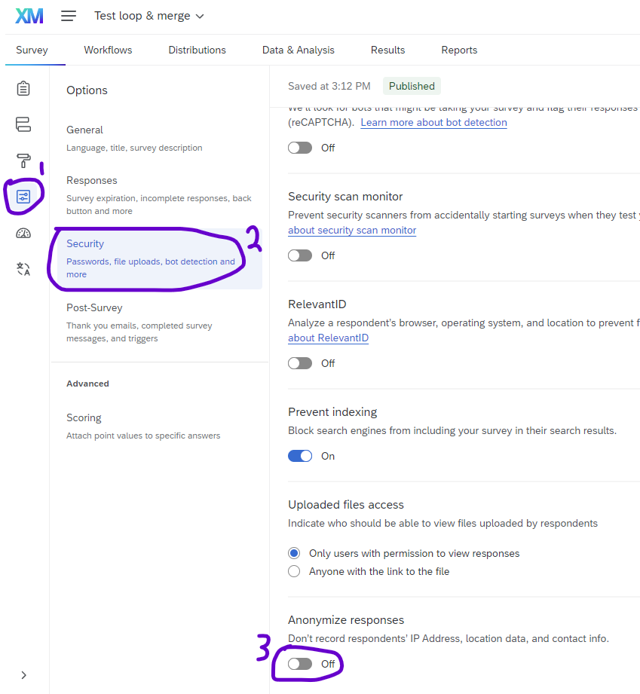
IP Address collection
Qualtrics collects respondents’ locations and IP addresses by default.
Often, you can tell respondents their responses are confidential and leave the default settings.
To make responses truly anonymous, go to Security under Survey Options.
Anonymous surveys cannot be used for longitudinal data collection.
Note: This setting is applied to each survey separately.
Center for Innovation in Teaching & Learning (CITL)

Slide 60
Accessibility
Center for Innovation in Teaching & Learning (CITL)
60

Slide 61
Accessibility: Main Points
Use the “New survey taking experience”
Images need alt text; audio needs captions
Indicate where you use validation
  e.g., “Enter a whole number between 1 and 50”
If you modify color or font size, check readability and contrast
Center for Innovation in Teaching & Learning (CITL)

Slide 62
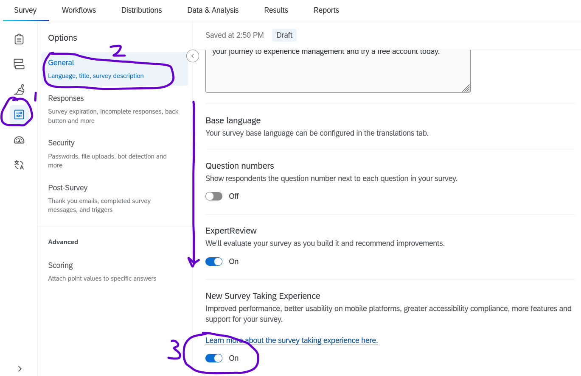
New Survey Taking Experience
In the future, this may be enabled by default.
For now: Enable it for each survey.
Center for Innovation in Teaching & Learning (CITL)

Slide 63
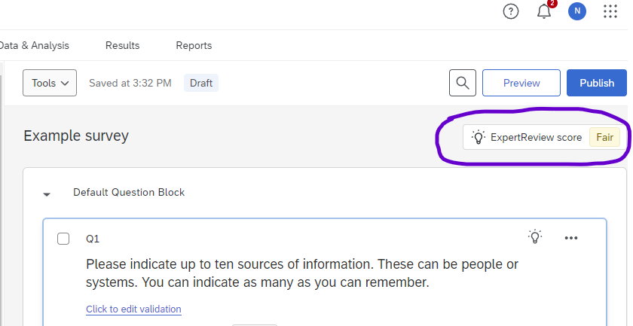
ExpertReview
ExpertReview is available for all surveys
Includes suggestions about accessibility and more
It is not perfect
Center for Innovation in Teaching & Learning (CITL)
Notes:
Try it: What does ExpertReview say about your survey right now?

Slide 64
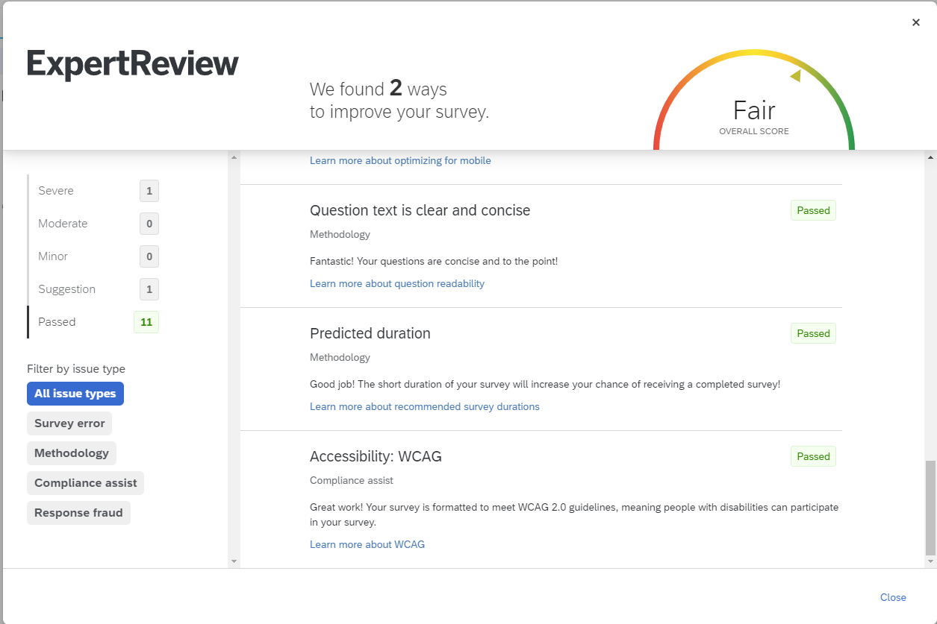
Limitations of ExpertReview
ExpertReview does NOT check
alt text, color, font size …
So, it’s a good start, but you will still have to check some things yourself
Remember, you are the final judge of what to include in your survey
Center for Innovation in Teaching & Learning (CITL)
Notes:
Try it: What does ExpertReview say about your survey right now?

Slide 65
Survey Distribution
Center for Innovation in Teaching & Learning (CITL)

Slide 66
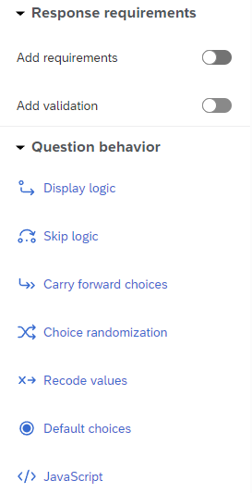
Recode values (1)
Data is saved with Labels and Values
  e.g., Freshman = 1
  Sophomore = 2
The values may surprise you!
Before publishing your survey, check the values
Center for Innovation in Teaching & Learning (CITL)

Slide 67

Recode values (2)
Center for Innovation in Teaching & Learning (CITL)

Slide 68

Preview
See how your survey looks
Test the logic
If you preview the whole survey, your responses will be saved
  You can filter or delete them
Center for Innovation in Teaching & Learning (CITL)

Slide 69


Distribution
Anonymous link
Emails
Personal links
SMS message
  Faculty can purchase these via Webstore
Center for Innovation in Teaching & Learning (CITL)

Slide 70
Viewing Survey Responses
Center for Innovation in Teaching & Learning (CITL)

Slide 71

Test responses
You can generate test responses
Later, you can delete or filter out the test responses
Center for Innovation in Teaching & Learning (CITL)

Slide 72

Results
Center for Innovation in Teaching & Learning (CITL)

Slide 73

Data & Analysis (1)
Center for Innovation in Teaching & Learning (CITL)

Slide 74
Data & Analysis (2)
See the number of responses
  Recorded
  In progress
This page loads slowly
Center for Innovation in Teaching & Learning (CITL)

Slide 75
Data export (1)
Export to analyze the data elsewhere
  Excel
  SPSS
  R
  Python
  etc.
Center for Innovation in Teaching & Learning (CITL)

Slide 76

Data export (2)
Various formats available
Most common:
  Excel
  SPSS
  csv
Center for Innovation in Teaching & Learning (CITL)

Slide 77
Data export (3)
Values
  1
  3
  17
Labels
  Hamburgers
  All the time
Center for Innovation in Teaching & Learning (CITL)

Slide 78

Data export (4)
Center for Innovation in Teaching & Learning (CITL)

Slide 79
Export structure
Each row is a respondent
Each column is a variable
  Metadata
    (i.e., Recorded Date, IP Address, etc.)
  Contact fields
  Survey questions
  Any embedded data
Center for Innovation in Teaching & Learning (CITL)

Slide 80

Export structure (example: csv)
Question label
Question text
{metadata}
Response 1
Response 2
…
Center for Innovation in Teaching & Learning (CITL)

Slide 81
Thank you!
Nathan Jeffery
nathanj3@illinois.edu
Center for Innovation in Teaching & Learning (CITL)

